Slide 1

Django Authentication
Authorization, Authentication, Login & Registration
Program: EDGE-CSE CUET DIGITAL SKILLS TRAINING
Course: Python (Django) [Intermediate]
Lecture: Training Session-10 Date: 12th October, 2024 Duration: (1+1) hours
Instructor: Tanveer Rahman, Sr. Software Engineer, Friends Corp. Chuo-ku, Tokyo, JP shakil10vr@hotmail.com, 01626735005

Slide 2
Agenda
User Authentication and Authorization
Implementing Login System
Implementing Registration System
Practical Tasks

Slide 3
Introduction to Django Authentication
User Authentication: Verifying the identity of a user (e.g., username and password).
User Authorization: Determining what an authenticated user can do (permissions, groups, etc.).
Django provides built-in support for user authentication with customizable views, models, and forms.

Slide 4
Authentication Workflow in Django
User submits login form with credentials.
Django authenticates the user by verifying credentials.
User session is created upon successful authentication.
Permissions are checked for accessing different views.

Slide 5
User Model Overview
Built-in User Model Attributes:
Customizing the User Model: Use Django's built-in AbstractUser or AbstractBaseUser.
username password email first_name, last_name

Slide 6
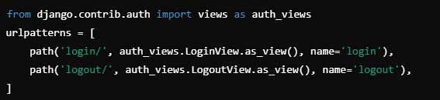
Setting Up Authentication in Django
Include Authentication URLs in the main urls.py
Configure Settings:
LOGIN_REDIRECT_URL = '/'
LOGOUT_REDIRECT_URL = '/'

Slide 7
Implementing Login
Create Login View:
Create a Login Template
Update URLs to include login.
Use Django's built-in LoginView.
Simple HTML form for username and password.

Slide 8
Task 1: Login System (30 Mins)
Create a login form using Django's LoginView.
Update URL configurations to include login and logout paths.
Create a simple login template to display the login form.

Slide 9
Implementing Registration
Create a Registration Form:
Create a View for Registration:
Update URL Configurations:
Use Django's UserCreationForm.
Handle form submission and user creation.
Add a path for registration.

Slide 10
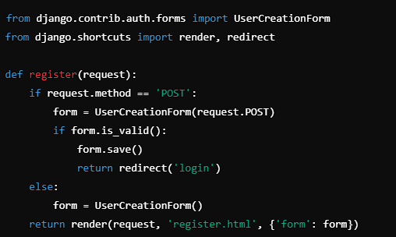
Registration VIEW Example
* view.py

Slide 11
Task 2: Registration System (30 Mins)
Create a registration view using UserCreationForm.
Add registration URL to your URL configurations.
Create a registration template to display the registration form.

Slide 12
Authorization with Permissions
Built-in Permission System:
Assign Permissions using Django Admin or code.
is_authenticated: Checks if the user is logged in.
is_staff, is_superuser: Special user statuses.
Custom permissions can be added to models.

Slide 13
Task 3: Implementing Permissions (15 Mins)
Add a custom permission to a model.
Use a view decorator to restrict access based on the permission.
Test the permission by logging in with different user roles.

Slide 14
recap
Authentication: Verifying user identity.
Authorization: Managing user permissions.
Login and Registration Systems: Implemented using built-in Django views and forms.

Slide 15
Additional Resources
Django Documentation: https://docs.djangoproject.com/en/stable/topics/auth/
Django Authentication and Authorization Guide

Slide 16

Q&A Session

